Slide 1

Third Review of Mini Project” For E3 2018 Batch Submitted as part of Mini Project G Satish -S180116 T. Ramesh -S180523 G. Srivalli -S180427 Under the Supervision of
Ms .J.VISHNU PRIYANKA Asst.prof
Department of Computer Science and Engineering
Rajiv Gandhi University of Knowledge Technologies Srikakulam
532402

Slide 2

Project Title
PARENT TEACHER PORTAL

Slide 3
Contents:
1. Abstract
2. Introduction
3.Problem statement
4. Existing System
5.Proposed System
6. Software & Hardware Requirements
7. Future Scope
8. Reference
9. Conclusion

Slide 4
1.Abstract:
The Parent-Teacher Portal is a web-based platform for seamless and transparent communication and collaboration between parents and teachers, including student feedback, attendance tracking, leave requests and enhancing parental involvement and improving outcomes. The project delivers a user-friendly interface, secure management, and rigorous testing for reliability. It streamlines tasks, promotes transparency, and supports student success.

Slide 5
2.Introduction:
The Parent-Teacher Portal project aims to transform the way parents and teachers communicate and collaborate in the realm of education. By introducing innovative features such as a student feedback system, student college premises tracking system, and student leave request system, the project seeks to establish a direct and transparent line of communication between these key stakeholders.
The project aims to enhance parental involvement, promote collaboration, and ensure the holistic development of students. Through this initiative, the project strives to optimize communication processes, provide timely updates and feedback, and establish a user-friendly interface that empowers parents and teachers to work together towards the educational success of each student.

Slide 6
3.Problem-Statement:
Inefficient communication and collaboration between parents and teachers.
Limited Student progress monitoring.
Difficulty in accessing student information and updates.
Lack of a centralized platform for submitting and managing student feedback.
Manual and time-consuming attendance tracking processes.
Limited parental involvement in their child's education.

Slide 7
4. Existing System:
The existing system for parent-teacher communication relies on in-person meetings, phone calls, and paper-based communication. It involves manual processes for tracking attendance and managing leave requests. However, this system suffers from limitations such as communication barriers, lack of timely feedback, limited transparency and difficulty in collaboration.
Disadvantages :
Inefficiency and time-consuming processes
Communication barriers and miscommunication
Administrative inefficiencies and delays
Lack of timely feedback and support
Limited transparency in sharing information
Difficulty in collaboration between parents and teachers

Slide 8
5.Proposed System:
Proposed System The proposed Parent-Teacher Portal aims to improve communication and transparency between parents and teachers. It includes features like student feedback submission, student college premises tracking, direct interaction ,leave request management, user friendly interface to access the Portal. This system makes communication easier, helps parents and teachers work together and simplifies administrative processes for better student outcomes and increased parental involvement.
Advantages:
Accessible Feedback Submission
Real-Time Student Tracking
Efficient Leave Request Management
User-Friendly Interface
Increased Parental Involvement.

Slide 9
6.Software Requirements & Hardware Requirements:
Software Requirements:
Operating System: Windows 10 or Mac OS X 10.15 or higher
Web Browser: Chrome, Firefox, or
Database: MySQL or SQL Server
Programming Languages: PHP, JavaScript, HTML, and CSS
Content Management System: WordPress
Microsoft office.

Slide 10
Hardware Requirements:
.Processor: Intel Core i3 or higher
. Memory (RAM): 4 GB or higher
. Storage: 100 GB or higher
.Display: 14-inch or higher with a minimum resolution of 1024x768
. Internet connection: High-speed broadband with a minimum speed of 2 Mbps

Slide 11
7.Future Scope:
The scope of the Parent-Teacher Portal project includes developing a web-based platform with features such as student feedback, college premises tracking, and leave request systems. The project encompasses, integrating with existing school systems, ensuring data security, providing training and support, and maintaining the portal's functionality. The primary objective is to enhance communication, streamline administrative processes, and improve the overall efficiency and effectiveness of parental involvement in their child's education

Slide 12
Frontend modules:
1.Student college Tracker
2.Student leave request
3.Student feedback

Slide 13
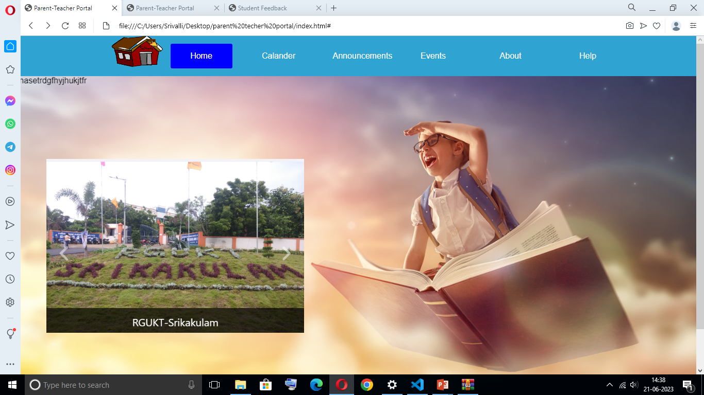
Main interface:

Slide 14
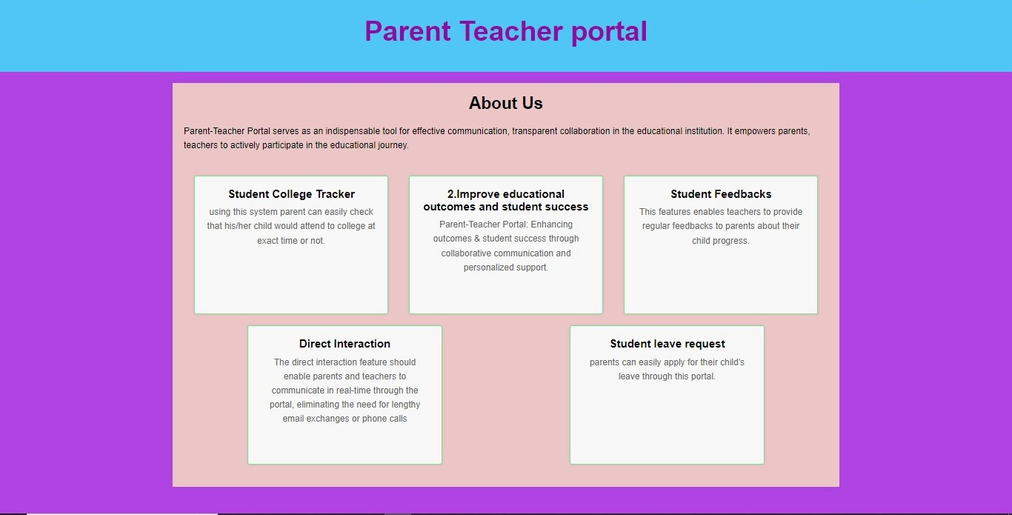
About:

Slide 15
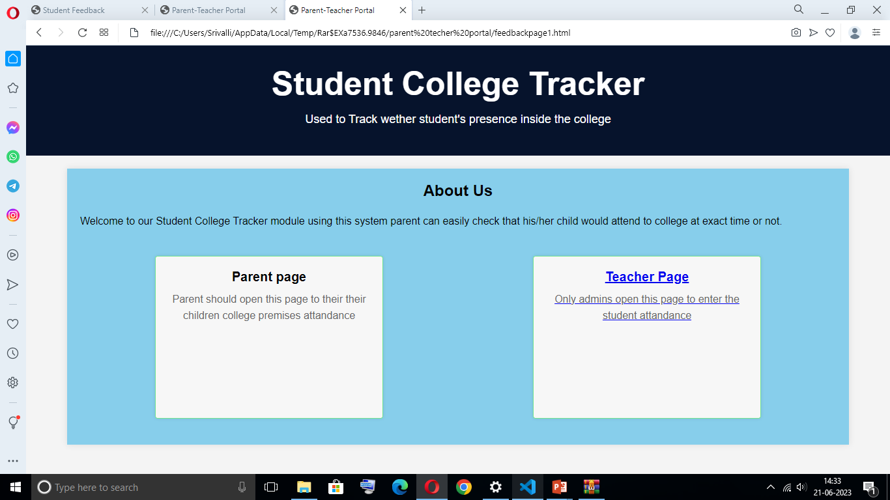
1.Student college Tracker:

Slide 16
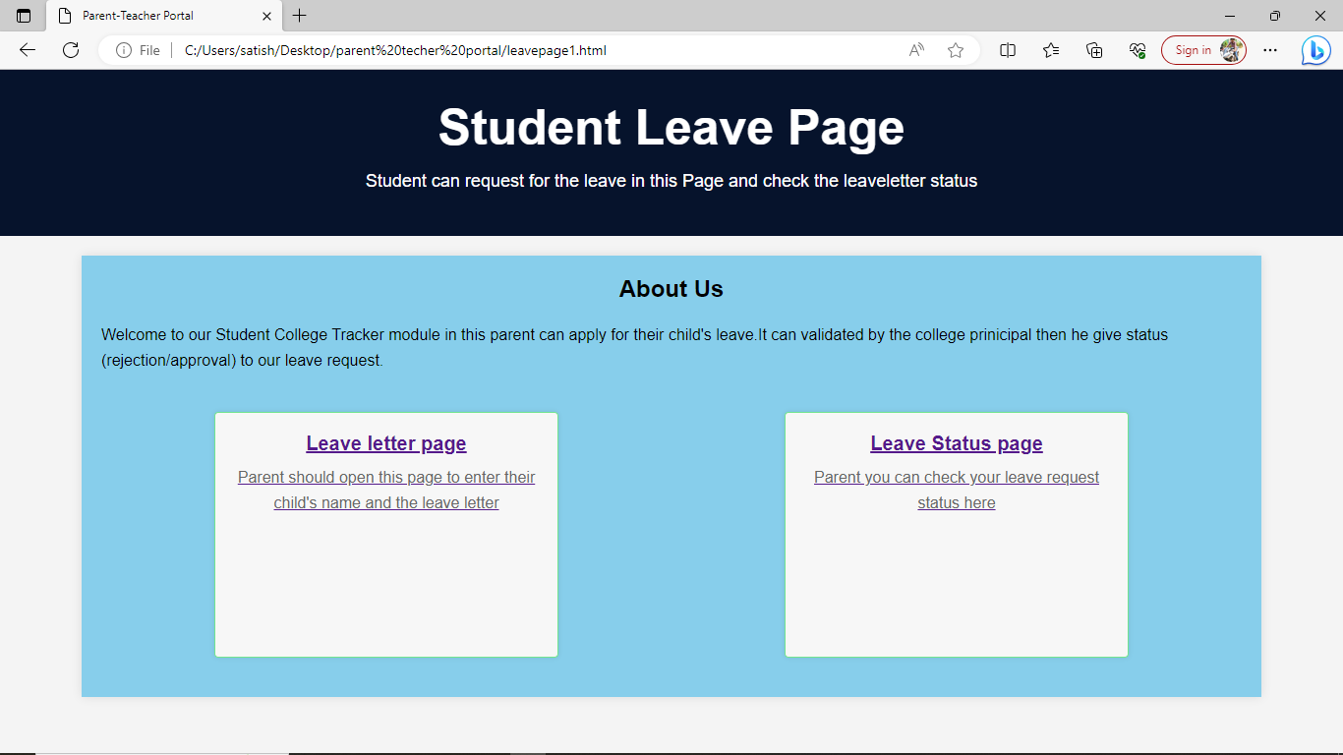
2.Student leave request:

Slide 17
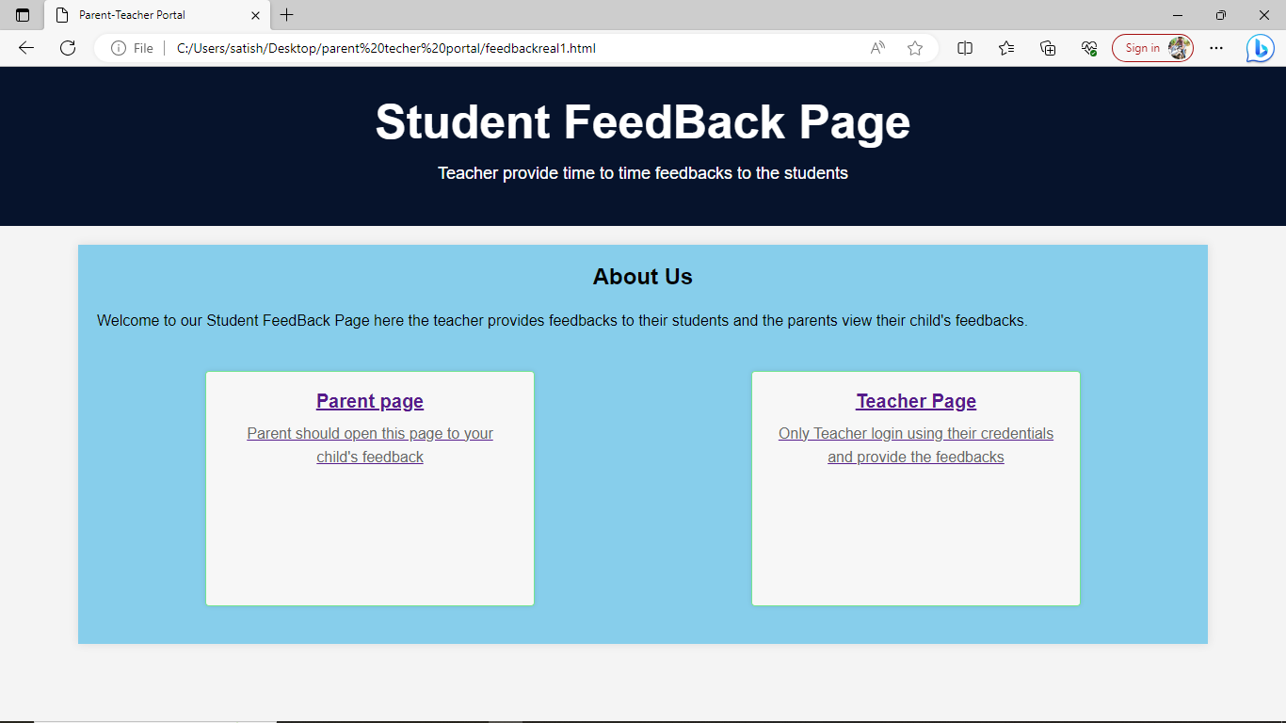
3.Student Feedback:

Slide 18
Backend Databases:
1.Leave table
2.students(feedback database)
3.student_attendance
4.teacher_registration

Slide 19
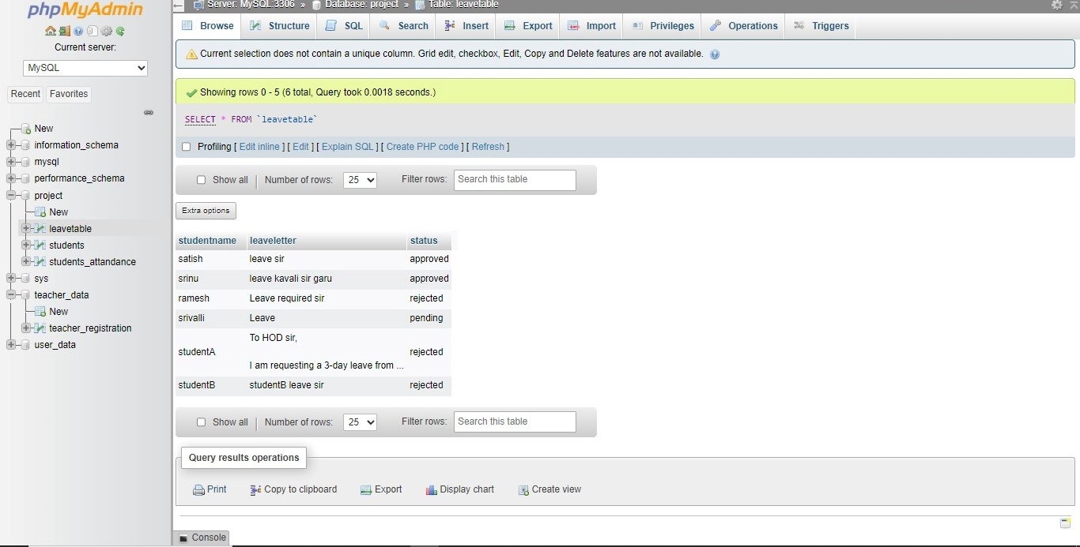
Leave Table:

Slide 20
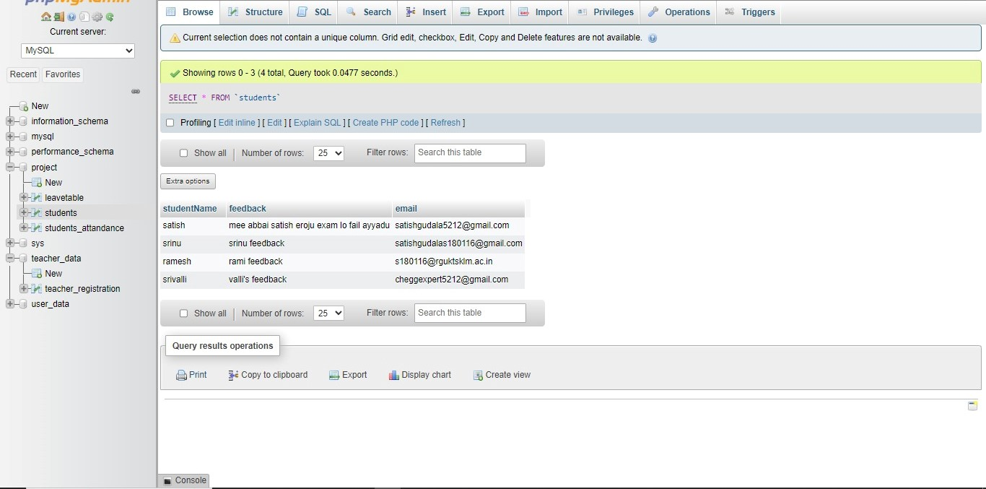
Student Feedback :

Slide 21
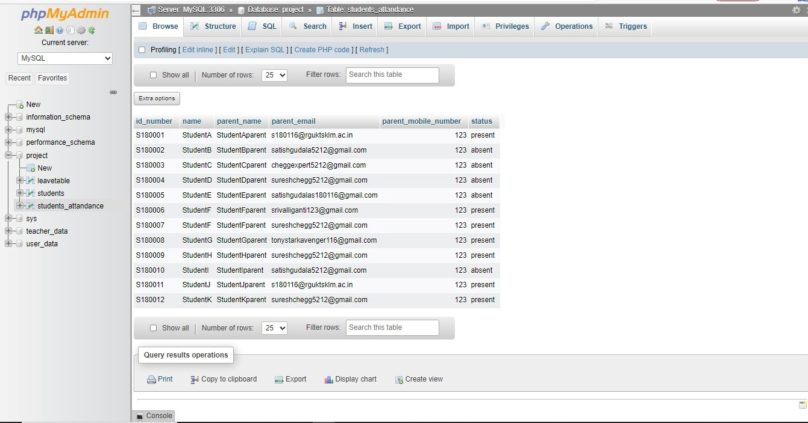
Student Attendance:

Slide 22
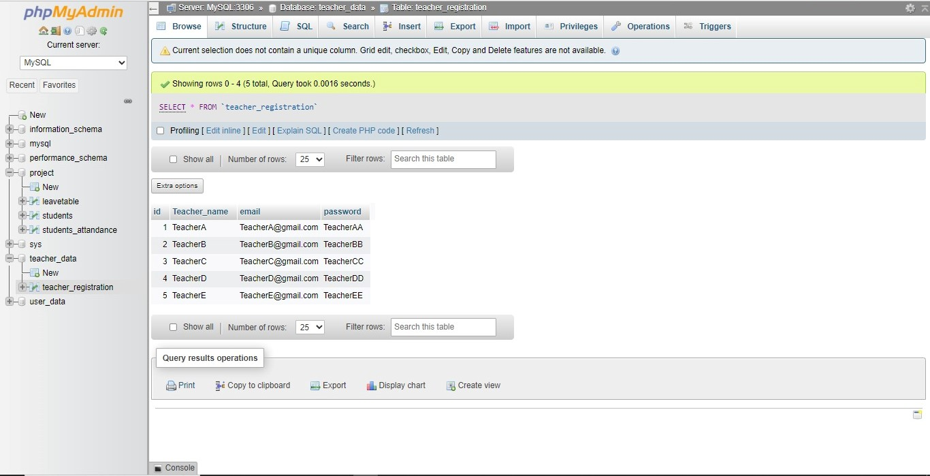
Teacher Registration:

Slide 23
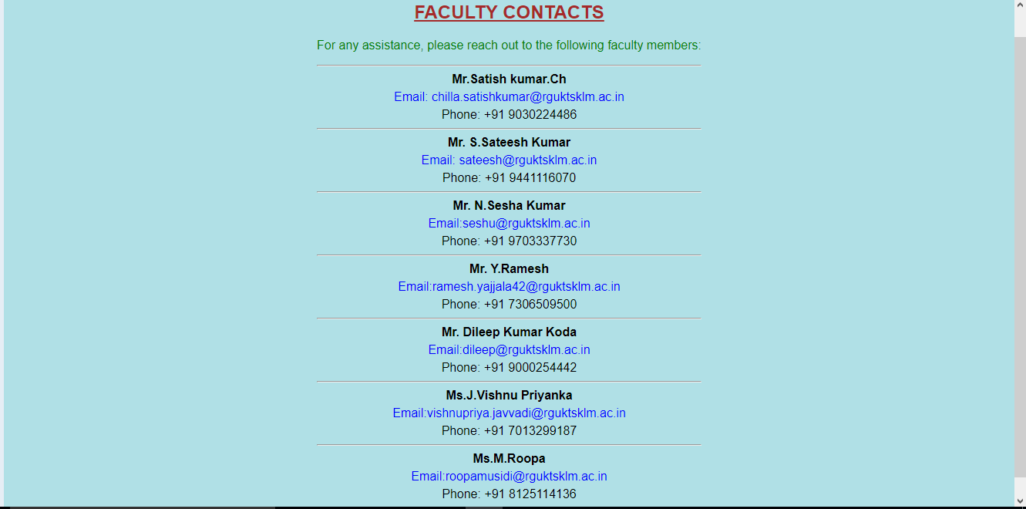
5.Assistance :

Slide 24
8.Reference:
https://ieeexplore.ieee.org/document/9974731
https://www.powerschool.com/
https://www.rgukt.ac.in/
www.google.com
https://www.edsys.in/parents/portal/ .

Slide 25
9.Conclusion:
The "Parent-Teacher Portal" project is an effective solution for enhancing communication and collaboration between parents and teachers. It includes features like student feedback submission, college premises tracking, and leave request management. By promoting direct interaction and transparency, the portal improves parental involvement and streamlines administrative processes. Through rigorous testing and continuous improvements, the project offers a reliable and user-friendly platform. Overall, the Parent-Teacher Portal project has the potential to improve educational outcomes and contribute to student success.

Slide 26
THANK YOU

